Slide 1




Sasi Kishore Varma
Sentiment Analysis
1 February, 2025

Slide 2
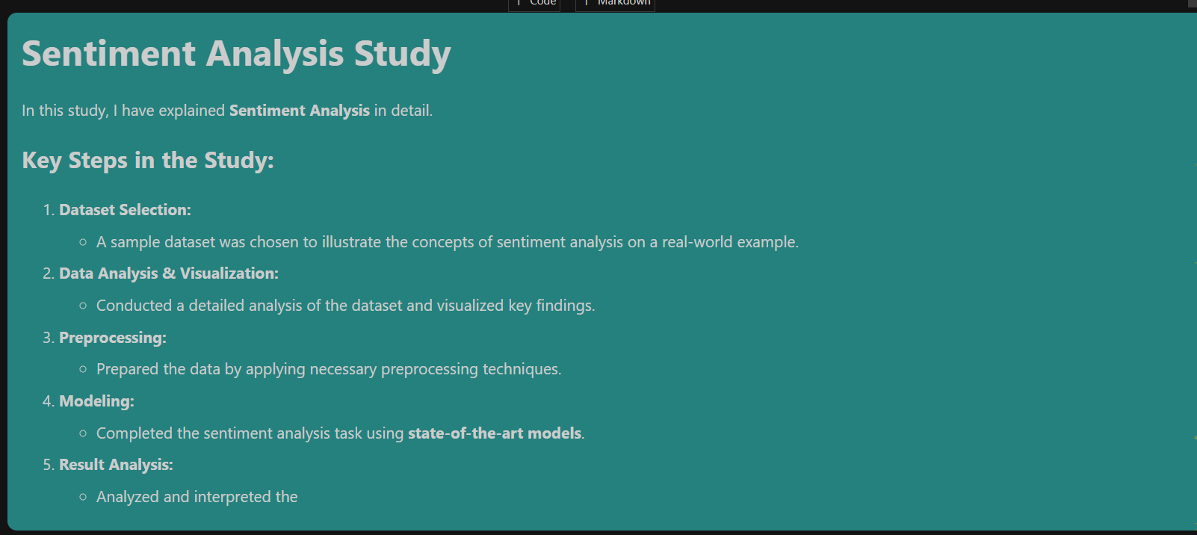

Slide 3

Introduction

Slide 4


Slide 5
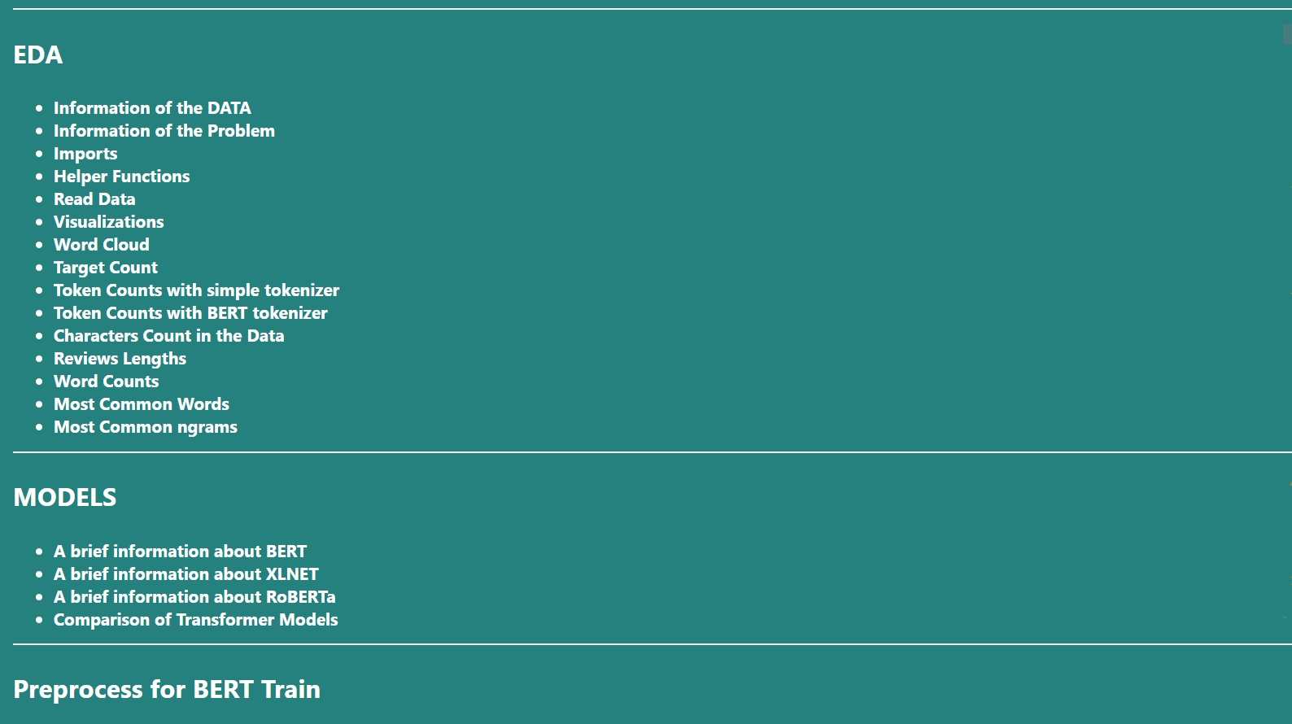

Slide 6
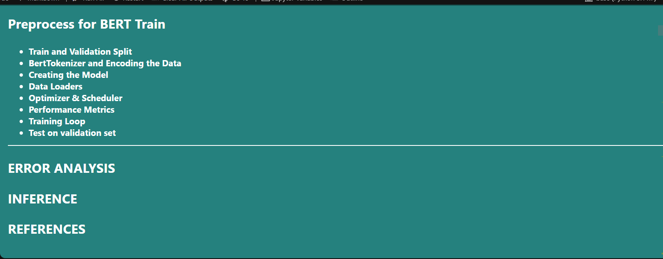

Slide 7
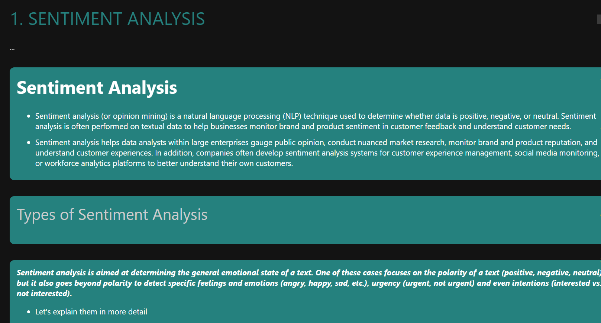

Slide 8
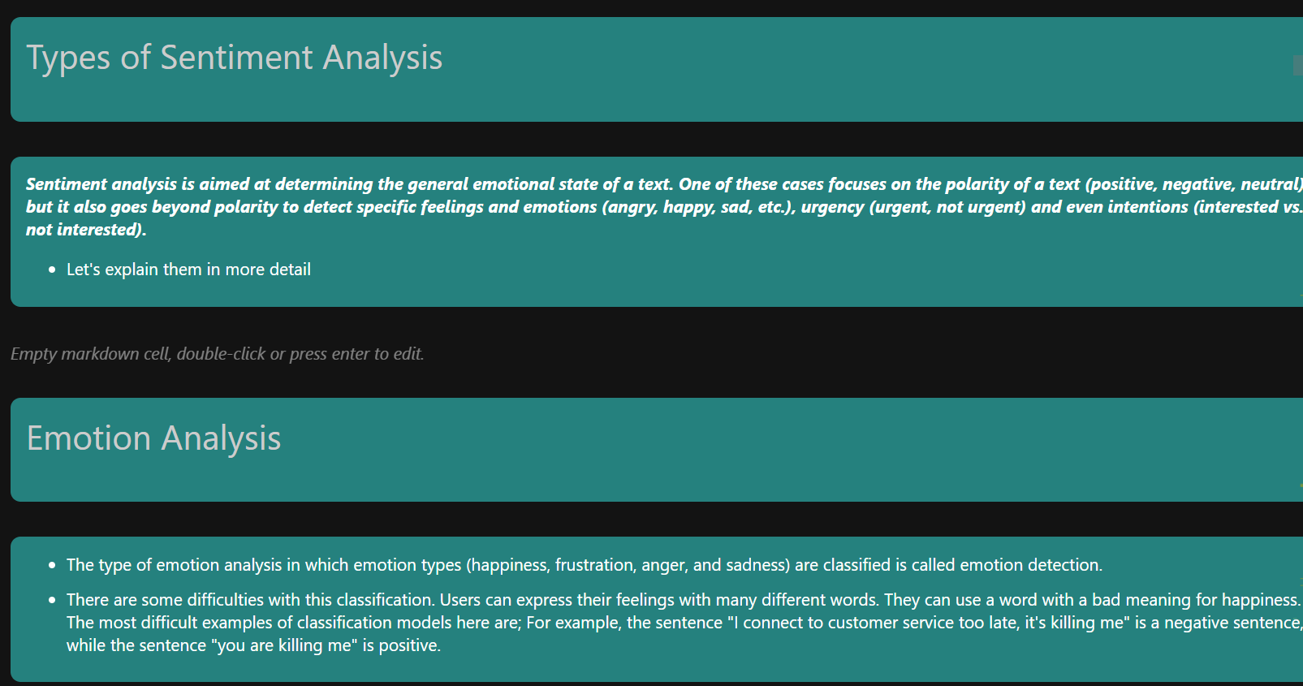

Slide 9
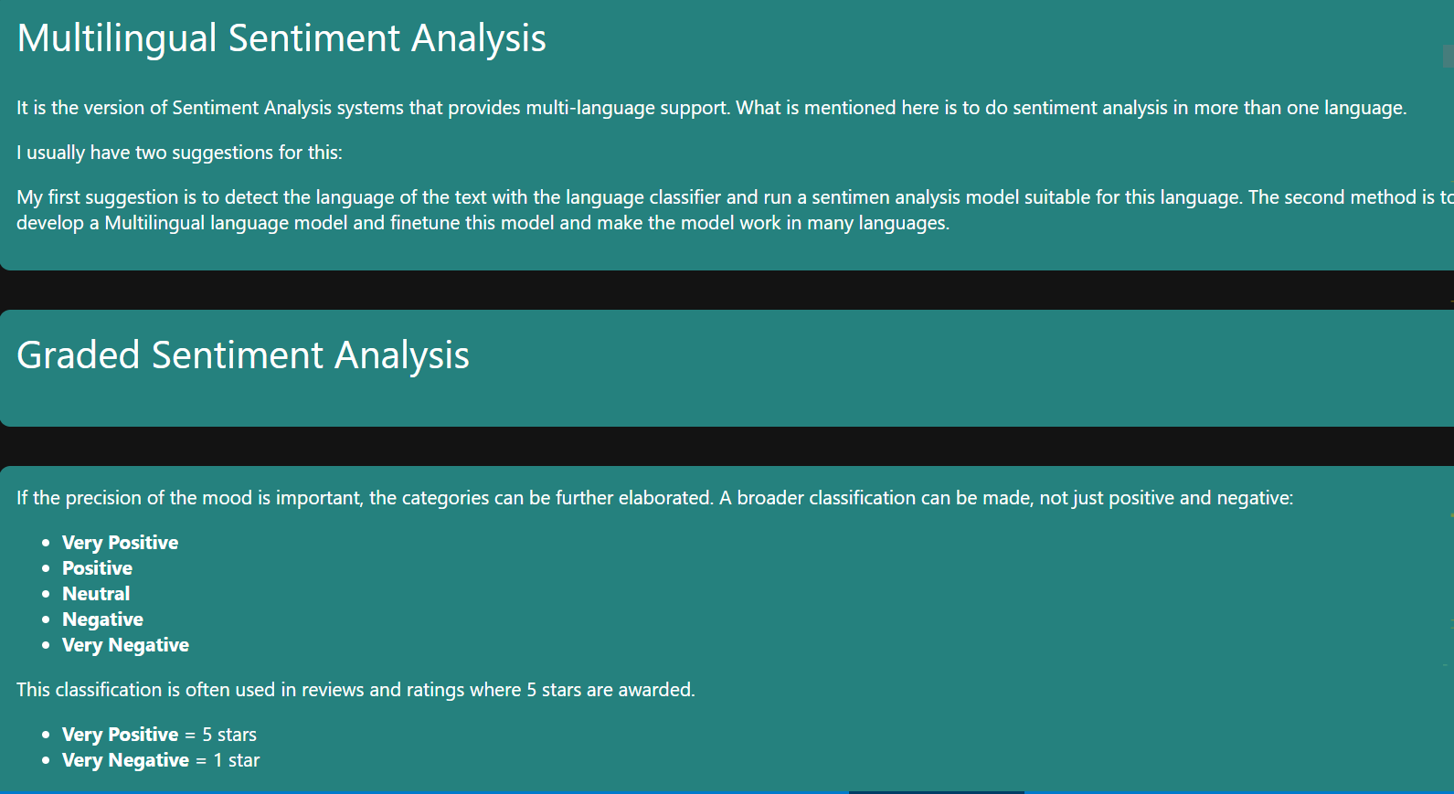

Slide 10
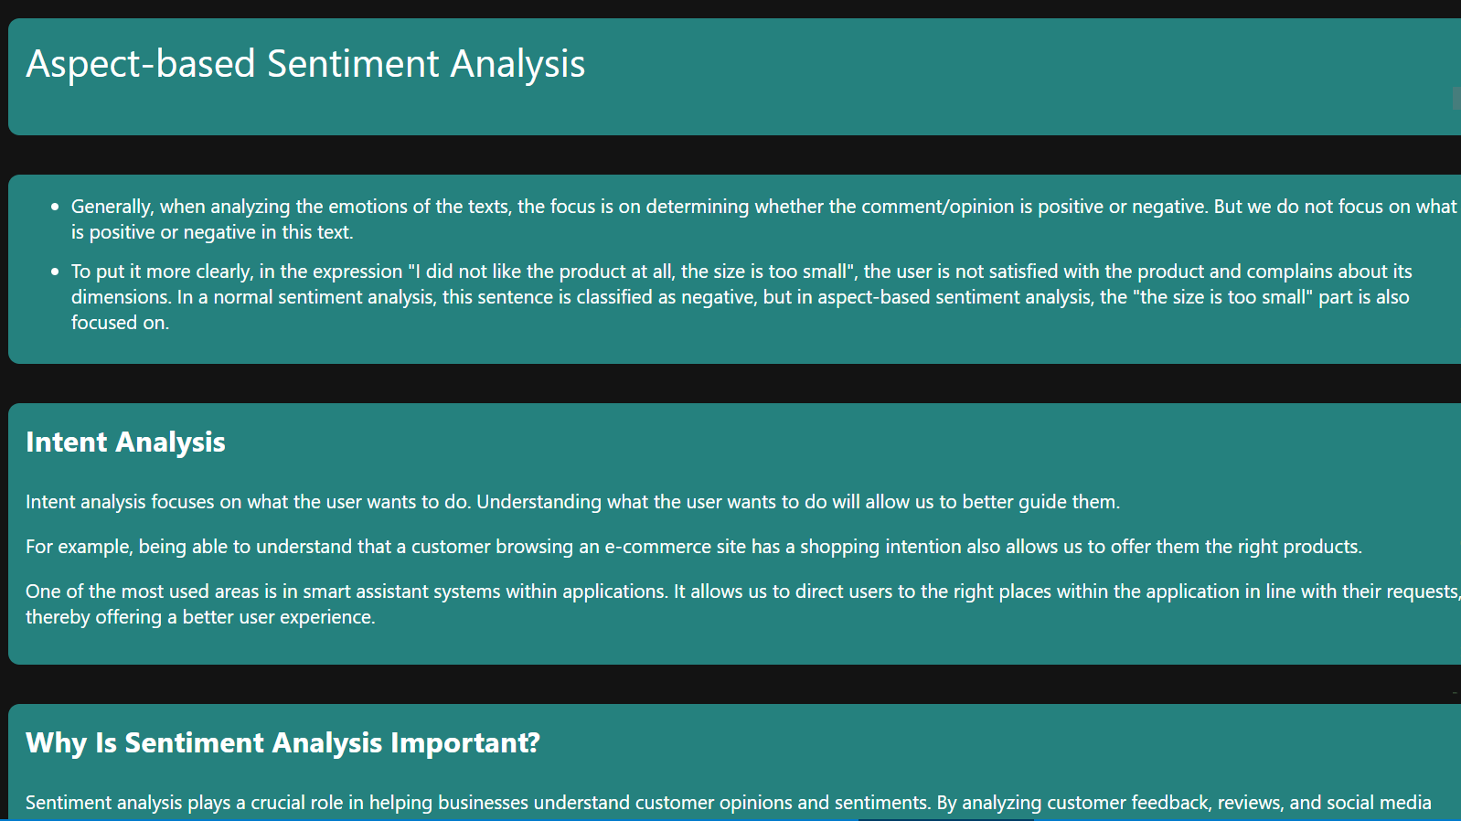

Slide 11


Slide 12


Slide 13
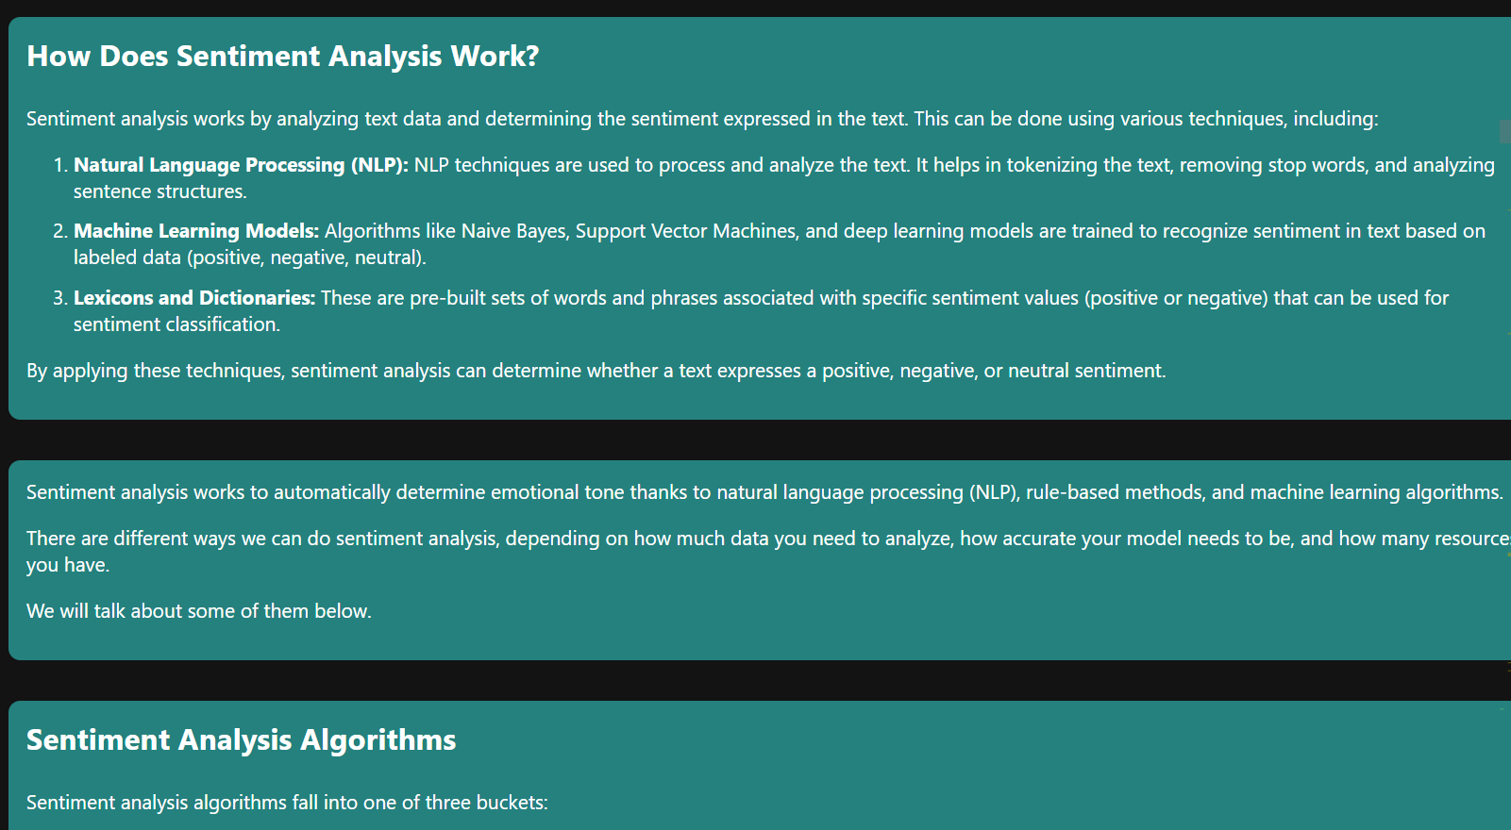

Slide 14
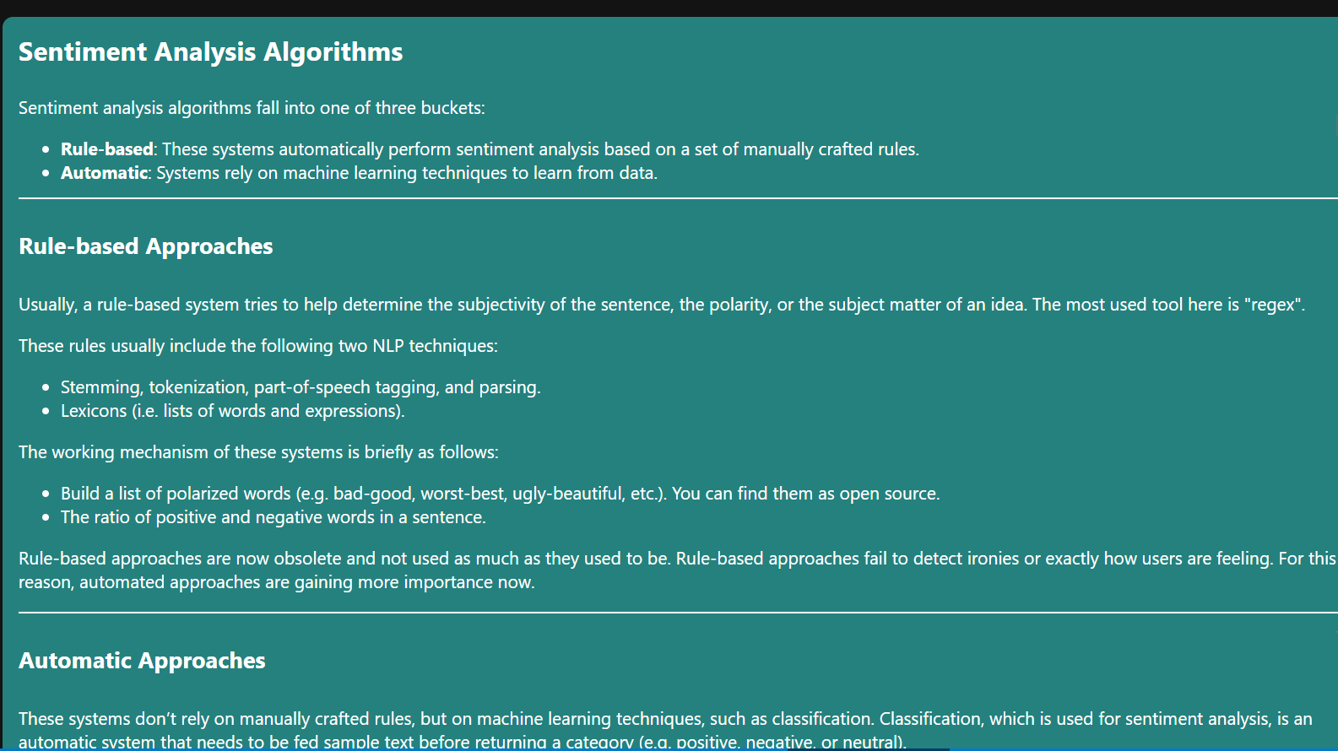

Slide 15
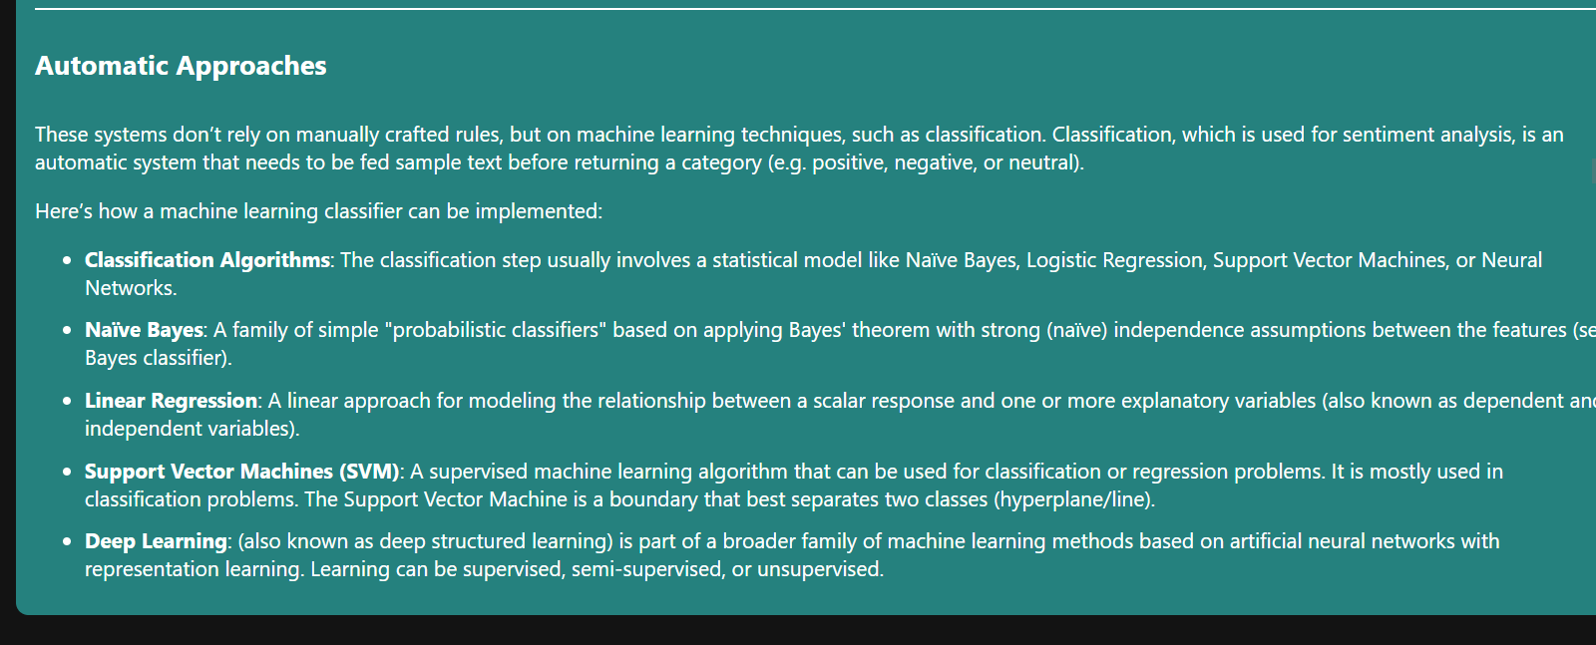

Slide 16
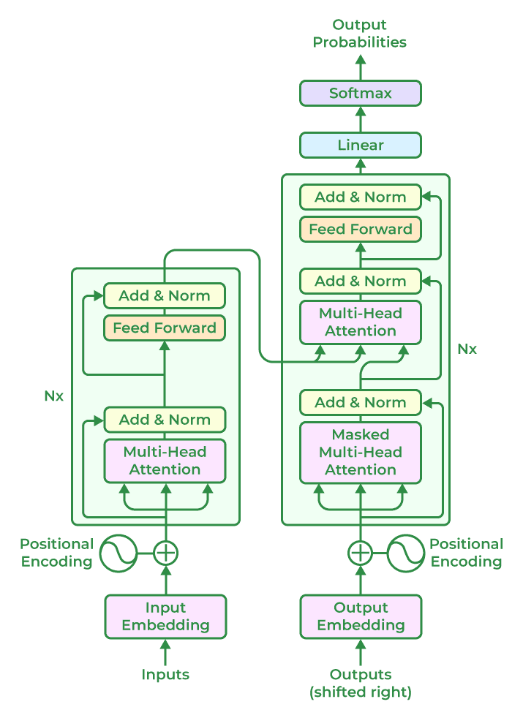
Transformer Architecture:
High-Level Overview
The transformer model is built on an encoder-decoder architecture, where both the encoder and decoder are composed of a series of layers that utilize self-attention mechanisms and feed-forward neural networks. This architecture enables the model to process input data in parallel, making it highly efficient and effective for tasks involving sequential data.
In a transformer model, the encoder processes the input sequence and generates a set of continuous representations. These representations are then fed into the decoder, which produces the output sequence. The encoder and decoder work together to transform the input into the desired output, such as translating a sentence from one language to another or generating a response to a query.

Slide 17
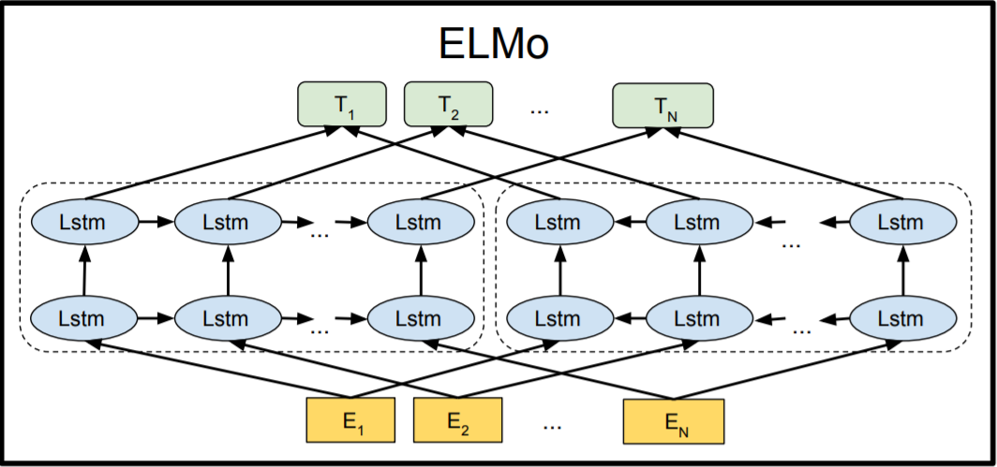
What is BERT?
BERT stands for Bidirectional Encoder Representations from Transformers. It is designed to pre-train deep bidirectional representations from unlabeled text by jointly conditioning on both left and right context. As a result, the pre-trained BERT model can be fine-tuned with just one additional output layer to create state-of-the-art models for a wide range of NLP tasks.

Slide 18
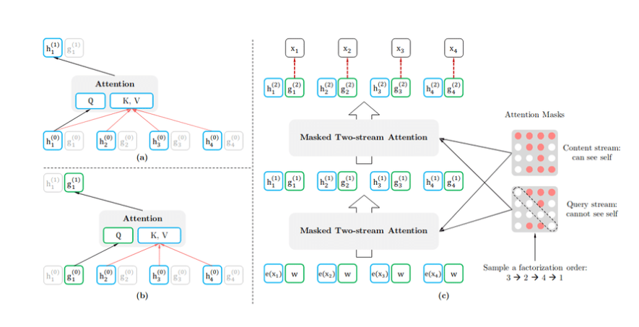
Architecture of XLNet
XLNet comprises input embeddings, multiple Transformer blocks with self-attention, position-wise feedforward networks, layer normalization, and residual connections. Its multi-head self-attention differs by allowing each token to attend to itself, enhancing contextual understanding compared to other models.

Slide 19



Slide 20

Thank you

